Slide 1

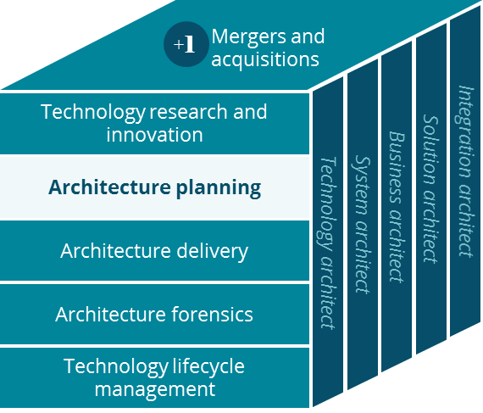
Retail Pharmacy Business Canvas
Architecture Planning
Ravi Vangala
4/3/2019

Slide 2
Retail Pharmacy Business Canvas
Holistic view of the current Retail Pharmacy business model
Key Partnerships
Key Activities
Value Proposition
Customer Relationships
Customer Segment
Rx drug fulfillment
Clinical activity
Prescription drug fulfillment
Individual patients
PBMs
US domestic population who are in need of medication and associated care management.
Patient care management
Inventory management
Targeted Clinical Support: New Script Pick Up, Welcome Counsel, First Fill Counsel, etc.
Care givers
Manufacturers
Home delivery
Suppliers
Adherence Programs: Adherence Outreach, Automated Outreach, Gaps in Care, Multi-Dose Packs, 90 Day, etc.
Key Resources
Channels
SureScripts (route eRx)
In person
Email
Skilled Rph & technician
RelayHealth
Proactive Care to Support Patient Health:
Care 1-on-1, HealthTag®, Immunizations, Naloxone Dispensing, Natural Disaster Alerts, Pharmacy Advisor, Rph Counseling etc.
Local real-estate
Phone
Web/ Mobile app
Prescribers
Supply-chain and logistics
Text
Home delivery
Cost Structure
Revenue Streams
Pharmacist wages are most expensive with about 75,000 pharmacists across 10,000 stores paid at ~$65/hour. Several state regulations require Rph overlaps.
Timely prescription fills and care management
at a convenient local store or delivered to home.
Store real-estate is very expensive especially in urban areas.
Our customers pay us by leveraging their health insurance services as well as their portion of the co-payment via cash or credit/debit cards
Pharmacy operations

